Slide 1
AC6761 Artificial Intelligence Accounting
Chapter 11 Hands-on AI Application, Ethical Considerations and Future Trends of AI

Slide 2
Agenda
Machine Learning for Financial Forecasting
Ethics in AI
Future Trend of AI

Slide 3
What is Machine Learning?​
Traditional Programming:​​​​Input:​​ Data + Rules/Program
​​Output:​​ Answers
​​Machine Learning:​​​​Input:​​ Data + Answers
​​Output:​​ Rules/Model

Slide 4
Financial Forecast & Machine Learning
E.g., Forecasting Stock Price:​​ Using historical data where we know the final price to predict future prices.
Supervised Learning: Algorithm learns from ​​labelled data​​.
The relationship between historical financial data and stock price (labelled data) is used to train AI.
Financial forecast is a typical application of Supervised Learning.

Slide 5
The Supervised Learning Process​
Core Idea:​​ Learn a function (a ​​model​​) that maps input variables (X) to an output variable (Y).
Process Flowchart:​​​​
Historical Data:​​ Collect data where we know both the ​​Features (X variables)​​ and the ​​Target (Y variable)​​.
​​Training:​​ The algorithm analyzes the data to find the "best" mathematical relationship between X and Y. This creates the ​​model​​.
​​Prediction:​​ Use the trained model with ​​new X data​​ (where Y is unknown) to ​​forecast the future Y​​.

Slide 6
Example
​​X Variables (Features):​​ [Book-to-Market Ratio, Company Size, Profitability]
​​Y Variable (Target):​​ Next Year's Stock Return
​​Model:​​ Predicted Return = f(Book-to-Market, Size, Profitability)

Slide 7
Tools for Machine Learning Forecasting​
Tool | Type | Key Feature for Forecasting
​​Python | Open-Source Programming | Highly flexible, vast library of algorithms, industry standard for AI research.
​​R​​ | Open-Source Programming | Excellent for statistical analysis and prototyping new models.
​​SAS​​ | Commercial Software | ​​Enterprise-grade reliability​​, excellent for handling large datasets, strong emphasis on model validation and deployment.
​​Stata​​ | Commercial Software | Popular in econometrics, strong for panel data analysis, but less focused on modern ML.

Slide 8
Introduction to SAS for Machine Learning
What is SAS?​​
A software suite for ​​advanced analytics, multivariate analysis, and predictive modeling​​.
Uses a procedural language where you call pre-defined routines (​​PROCEDURES​​ or ​​PROCs​​).

Slide 9
Key SAS Procedures for Machine Learning:​
PROC Name | Purpose
​​PROC REG​​ | Linear Regression | The foundational predictive model.
​​PROC LOGISTIC​​ | Classification (e.g., bankrupt/not bankrupt)
​​PROC GLMSELECT​​ | ​​Advanced regression with variable selection​​ (e.g., LASSO). ​​Prevents overfitting.​​
​​PROC HPFOREST​​ | Random Forests - a powerful, non-linear ML algorithm.

Slide 10
Case Study: Predicting a Firm's Stock Price​
Research Question:​​
Can we use a firm's financial characteristics today to predict its stock price one year from now?

Slide 11
Our plan
​​Define the Target (Y):​​ Stock Price in One Year
​​Define the Features (X):​​ Firm's financial ratios from its annual report.
​​Collect Data:​​ Historical data for many firms over many years.
​​Train a Model:​​ Use SAS to find the relationship between X and Y.
​​Make a Prediction:​​ Apply the model to a specific firm's latest data.

Slide 12
Step 1 — Defining Features (X) from Financial Theory​
Category | Predictor Variable (X) | Rationale
​​Value​​ | Book-to-Market Ratio (B/M) | High B/M ("value" stocks) often outperform.
​​Profitability​​ | Return on Equity (ROE) | More profitable firms should have higher returns.
​​Investment​​ | Asset Growth (AG) | Firms growing assets too fast may have lower future returns.
​​Momentum​​ | Prior 1-Year Return (MOM) | Stocks with good recent performance may continue.
​​Size​​ | Log of Market Capitalization (SIZE) | Smaller firms may have higher expected returns.

Slide 13
Step 2 — SAS Code: Data Preparation
/* 1. Import stock price data (e.g., from CRSP database) */ proc import datafile="/data/stock_prices.csv" out=prices dbms=csv replace; run;
/*2. Import financial statement data (e.g., from Compustat) */ proc import datafile="/data/financials.csv" out=financials dbms=csv replace; run;
/* 3. Calculate the features (X variables) for each firm-year */ data features; set financials; by gvkey fyear; /* Group by firm and fiscal year */ /* Calculate predictor variables */ BM = bkvlps / prcc_f; /* Book-to-Market Ratio */ ROE = ni / she; /* Return on Equity */ AG = (at / lag(at)) - 1; /* Asset Growth */ /* ... calculate other variables ... */ keep gvkey fyear BM ROE AG; run;

Slide 14
/* 4. Calculate the target (Y variable): Next year's stock return */ data target; set prices; by permno date; /* Group by stock and date */ /* Calculate return from today to one year in the future */ FutureReturn = ( (lead(price, 12) / price) - 1 ); keep permno date FutureReturn; run;
/* 5. Merge features and target into one dataset for modeling */ proc sql; create table model_data as select a.*, b.BM, b.ROE, b.AG from target as a left join features as b on a.permno = b.gvkey and a.date = b.fyear; quit;

Slide 15
Step 3 — SAS Code: Building the ML Model​
/* Split data into Training set (to build model) and Testing set (to validate it) */ data training testing; set model_data; if fyear <= 2020 then output training; /* Use older data to train */ else output testing; /* Reserve recent data for testing */ run;
/* Use PROC GLMSELECT to train the model with LASSO */ /* This procedure automatically selects the most important variables */ proc glmselect data=training; model FutureReturn = BM ROE AG SIZE MOM / /* List of X variables */ selection=lar (choose=sbc) stb; /* Use LASSO to avoid overfitting */ output out=model_out p=PredictedReturn; /* Save the model's predictions */ store work.forecast_model; /* Save the model to disk */ run;
​​Key Output:​​ A formula (model) like:
Predicted Return = 0.05*BM + 0.03*ROE - 0.08*AG + ...

Slide 16
Step 4 — Making the Forecast for 2026​
/* Create a dataset with Company XYZ's latest financials (2025) */ data xyz_2025; input BM ROE AG SIZE MOM; datalines; 0.85 0.15 0.05 23.1 0.10 ; /* These are XYZ's actual 2025 financial ratios */ run;
/* Use the PROCPLM to score (predict for) the new data */ proc plm restore=work.forecast_model; /* Load the trained model */ score data=xyz_2025 out=xyz_scored predicted=PredReturn2026; /* Make prediction! */ run;
/* Calculate the predicted 2026 price */ data final_forecast; set xyz_scored; CurrentPrice2025 = 150; /* Assume current price is $150 */ PredictedPrice2026 = CurrentPrice2025 * (1 + PredReturn2026); run;
/* Print the result */ proc print data=final_forecast; var CurrentPrice2025 PredReturn2026 PredictedPrice2026; run;

Slide 17
Final Output​​
Current Price (2025) | Predicted Return | ​​Predicted Price (2026)​​
$150 | + 8.2% | ​​$162.30​

Slide 18
Summary & Caveats
​​ML is Pattern Recognition:​​ We used historical patterns to inform a future prediction.
​​SAS is an ML Tool:​​ It provides powerful, validated procedures for building predictive models.
​​Process is Key:​​ Define target → Choose features → Prepare data → Train model → Predict.
The Forecast is Not a Guarantee:​​ It is a statement based on historical relationships.
​​Garbage In, Garbage Out:​​ The model's accuracy depends entirely on the quality of the data and the relevance of the chosen features.
​​Markets Change:​​ Relationships that held in the past may break down in the future.
@

Slide 19
Example of Python analyses
Predicting sales using linear regression
import pandas as pd
import numpy as np
from sklearn.model_selection import train_test_split
from sklearn.linear_model import LinearRegression
import matplotlib.pyplot as plt
#
data = {
‘advertising expenditure': [1000, 1500, 2000, 2500, 3000, 3500, 4000, 4500, 5000, 5500],
‘销售额sales': [2000, 2500, 3000, 4000, 4500, 5000, 6000, 6500, 7000, 8000]
}
df = pd.DataFrame(data)
#
X = df[[‘advertisement expenditure']]
y = df[‘sales']
#
X_train, X_test, y_train, y_test = train_test_split(X, y, test_size=0.2, random_state=42)

Slide 20
#
model = LinearRegression()
model.fit(X_train, y_train)
#
y_pred = model.predict(X_test)
#
plt.scatter(X, y, color='blue', label=‘actual sales data')
plt.plot(X_test, y_pred, color='red', label=‘predicted sales data')
plt.xlabel(‘advertisement expenditure')
plt.ylabel(‘sales')
plt.legend()
plt.title(‘sales prediction')
plt.show()
#
print(f’regression coefficient: {model.coef_[0]}, intercept: {model.intercept_}’)
@

Slide 21

Example of SAS analyses

Slide 22
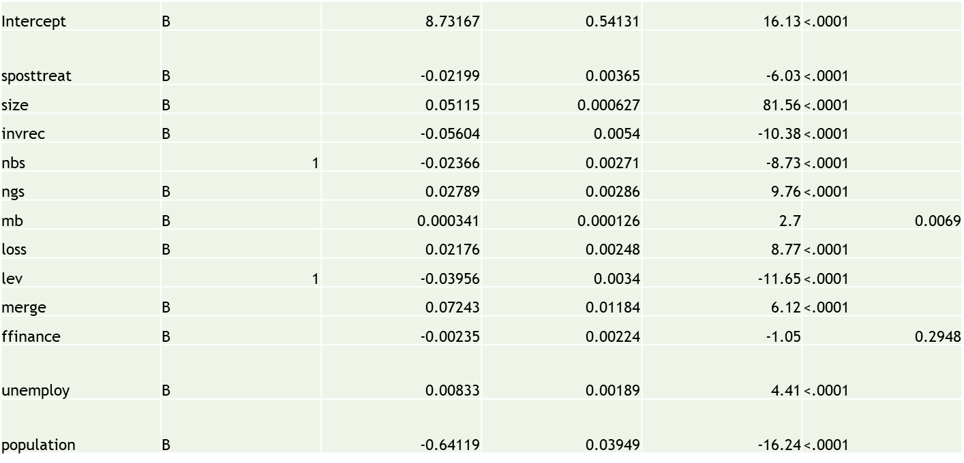
Example of SAS analyses

Slide 23
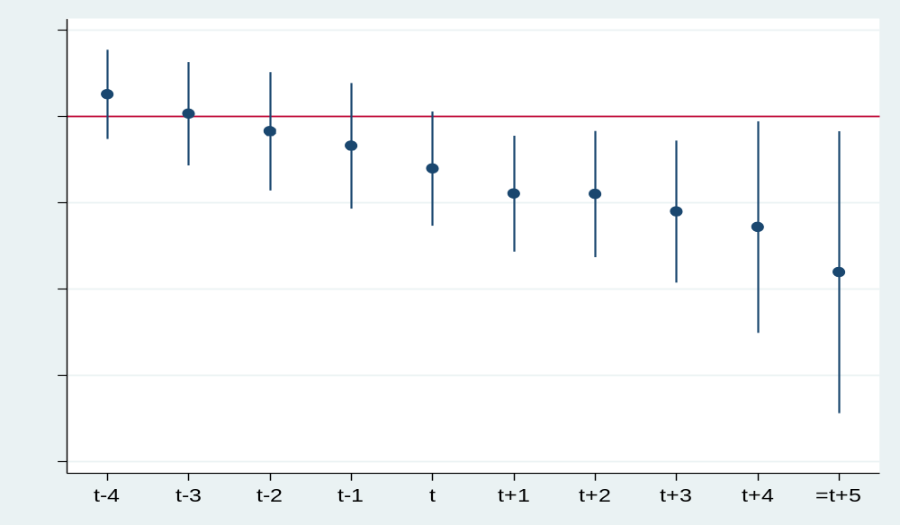
Example of STATA analyses

Slide 24
Ethics in AI
Data privacy and security
Bias and fairness
Transparency and explainability
Responsibility and accountability
@

Slide 25
Data privacy and security – Key concerns
AI systems often rely on large datasets, including sensitive financial information such as client data and transaction records.
Risks include data breaches, unauthorized access, and misuse of sensitive information.

Slide 26
Data privacy and security – Best practices
Implement data encryption to protect sensitive information.
Establish strict access controls to limit who can view and manipulate data.
Conduct regular security audits to identify and remediate vulnerabilities.

Slide 27
Bias and fairness - concept
Bias in AI can arise from unrepresentative training data, leading to unfair or discriminatory outcomes.
Example: An AI model trained predominantly on data from one demographic may not perform well for others, resulting in biased decisions.

Slide 28
Bias and fairness - Impact
Biased algorithms can lead to discriminatory practices in areas like hiring, lending, or auditing, undermining trust in AI systems.
Stakeholders may lose confidence in the accounting process if biases are detected.

Slide 29
Bias and fairness – Strategies for mitigation
Use diverse datasets to train AI models, ensuring representation across different demographics.
Regularly audit algorithms for bias using statistical methods and fairness metrics.
Engage with diverse teams to provide varied perspectives during model development.

Slide 30
Transparency and explainability - Challenges
Complexity of Models
Advanced AI models, like deep learning algorithms, can be highly complex, making it challenging to understand their decision-making processes.
Trade-Offs Between Accuracy and Interpretability
There’s often a trade-off between accuracy and interpretability. Complex models may perform better but are harder to explain. For example, a deep learning model may outperform a linear regression model in accuracy but lacks its interpretability.
“Black Box” Nature of AI
Many AI systems operate as “black boxes,” with internal workings that are not transparent to users. This lack of visibility can lead to skepticism and resistance to adoption.

Slide 31
Transparency and explainability - Improvement
Use simpler models, such as linear regression or decision trees, when possible for better interpretability.
Create visualizations (e.g., feature importance graphs) to illustrate how decisions are derived.
Provide comprehensive documentation of algorithms, the data used, and the rationale behind model choices.

Slide 32
Responsibility and accountability – who is responsible?
Clarify accountability for AI-driven decisions: should it lie with management, developers, or data scientists?
Establish clear guidelines on how responsibilities are allocated in AI applications.

Slide 33
Responsibility and accountability – Guidelines
Develop a framework outlining roles and responsibilities regarding AI use and decision-making.
Implement accountability measures such as regular reviews and audits of AI systems to ensure ethical compliance.

Slide 34
Key Trends Shaping the Future of AI in Accounting
Increased automation
Enhanced predictive analytics
Integration with Blockchain technology
Personalized client services
Continuous learning and adaption

Slide 35
Increased automation
Routine Task Automation
AI will increasingly handle repetitive tasks such as data entry, invoice processing, and bank reconciliations, reducing the time and effort required from accountants.
Example: Automated invoice processing systems that extract data from invoices and input it into accounting software with minimal human intervention.
Impact on Workforce
Traditional roles will evolve, leading to a shift in job responsibilities. Accountants will spend less time on mundane tasks and more on strategic activities.
Reskilling Opportunities: Accountants will need training in AI tools, data analysis, and strategic advisory to adapt to new roles.

Slide 36
Enhanced predictive analytics
Leveraging Big Data
AI will utilize vast datasets to analyze trends, enabling firms to make informed predictions about financial performance.
Machine Learning Models: Algorithms will identify patterns and forecast future outcomes, such as cash flow trends or revenue growth.
Real-Time Insights
Businesses will benefit from real-time analytics, allowing for timely decision-making based on current data rather than historical reports.
Scenario Analysis: AI can simulate various financial scenarios, helping firms prepare for potential market changes or economic fluctuations.

Slide 37
Integration with Blockchain technology
Improved Transparency
Combining AI with blockchain technology can enhance the transparency of financial transactions, making it easier to track and verify transactions.
Example: Smart contracts that automatically execute transactions when predefined conditions are met, reducing the need for manual oversight.
Security and Fraud Prevention
Blockchain’s decentralized nature adds a layer of security, making it harder for fraud to occur. AI can analyze blockchain data to detect anomalies and potential fraud in real time.
Audit Efficiency: AI tools can quickly analyze blockchain records, streamlining the audit process and ensuring compliance.
@

Slide 38
Personalized client services
Tailored Recommendations
AI will enable accountants to offer personalized financial advice by analyzing individual client data and preferences.
Example: AI-driven platforms can suggest optimal investment strategies or tax-saving opportunities based on a client’s unique financial situation.
Enhanced Communication
Natural Language Processing (NLP) will facilitate more intuitive interactions between clients and AI systems, allowing clients to ask questions and receive instant, accurate responses.
Chatbots and Virtual Assistants: These tools can handle client inquiries, provide updates on financial status, and assist with basic accounting tasks.

Slide 39
Continuous learning and adaption
AI Systems that Learn
Machine learning algorithms will continuously learn from new data, improving their accuracy and effectiveness over time.
Adaptability: As market conditions and regulations change, AI systems can adjust their models to remain compliant and effective.
Feedback Mechanisms
Incorporating feedback loops into AI systems will allow for ongoing refinement and improvement, ensuring that the tools remain relevant and useful.
User Engagement: Encouraging user feedback on AI outputs can help enhance system performance and address any ethical concerns.

